Slide 1
TECH AGRI USING MACHINE LEARNING
PIP104 University Project-II
FINAL PRESENTATION
Batch Number:08
Roll Number | Student Name
20201cei0059 | j.Thirumalareddy
20201cei0057 | Narendra reddy
20201cei0065 | p.Vishnu teja rao
20201cei0044 | Vinay G.L
Under the Supervision of,
Dr.SUDHA.P
Assistant Professor(SG)
School of Computer Science & Engineering
Presidency University

Slide 2
Introduction
Welcome to the Tech agri for Farmer innovative and intelligent platform revolutionizing agriculture through the power of machine learning. Our portal takes the guesswork out of farming by utilizing key inputs such as nitrogen, phosphorus, potassium, pH level of water, and location to provide accurate predictions on the optimal crop for cultivation.
Imagine having a virtual agricultural advisor at your fingertips, capable of analyzing the unique conditions of your farm and offering personalized recommendations. The Farmer Portal does just that. By harnessing the capabilities of machine learning, it processes data to discern patterns, identify correlations, and generate insights that guide farmers towards informed decisions.

Slide 3
Literature Review
The conducted Systematic Literature Review (SLR) aimed to comprehensively explore the landscape of AI technologies applied in the agricultural sector and their role in achieving sustainability objectives. This extensive review, following the methodology outlined by Kitchenham and Charters (2007) and Ferreras-Fernández et al. (2013), underwent meticulous planning, implementation, and reporting stages.
In the planning phase, key terms integral to the study—such as agriculture, farming, AI, Deep Learning, Machine Learning, and agricultural robotics—were identified. Boolean operators, including AND and OR, were strategically employed to conduct in-depth searches across prominent databases like Google Scholar, Scopus, Science Direct, and Web of Science. The scope was limited to scholarly journal and conference articles in English, within the last ten years, aligning with the study's objectives.

Slide 4
Literature Review
During the implementing phase, the search tools retrieved a total of 1421 articles across the selected databases. Specifically, 347 records were found in Web of Science, 256 in Scopus, 244 in Science Direct, and 574 in Google Scholar. These articles spanned diverse fields like agriculture, technology, computer sciences, and sustainability. A stringent review process ensued, involving manual scrutiny of titles, keywords, abstracts, and text analysis to align with the study's goals. After eliminating duplicate entries and excluding 131 articles deemed irrelevant to the agricultural industry, a final sample of 115 eligible articles emerged.
This curated set of articles, comprising 45 from Web of Science, 37 from Science Direct, and 33 from other sources, was meticulously finalized by December 2021.

Slide 5
Objectives
Optimized Crop Recommendation: Develop an AI-driven application that integrates data from various sources such as monsoon predictions, climate conditions, soil health, pest and disease forecasts, and market demand to recommend the most suitable crops for specific geographical locations.
Real-time Decision Support: Offer real-time and dynamic recommendations to farmers based on their field's geographic location, considering current and forecasted weather patterns, soil conditions, and pest predictions.
Sustainable Farming Practices: Encourage sustainable and environmentally friendly farming by suggesting crops that align with soil conditions, require fewer insecticides, and reduce the overall environmental impact.
Market Trend Analysis: Utilize market data and trends to guide farmers in selecting crops that have a higher demand in the market, allowing them to make informed decisions for better profitability.
Supply Chain Management: Provide information about the availability of fertilizers and insecticides in the area to support farmers in their crop cultivation plans.

Slide 6
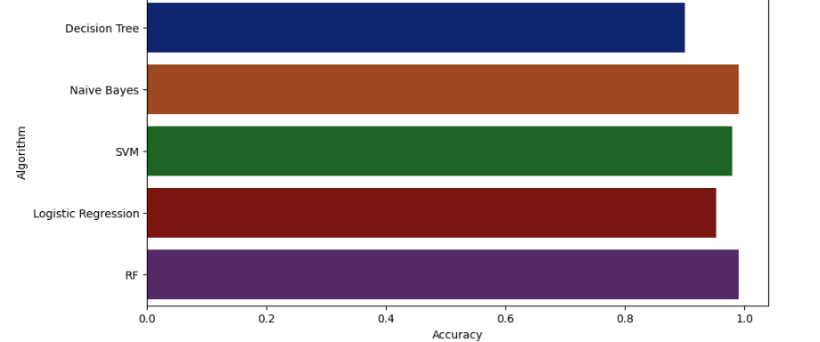
Proposed Method
Machine Learning Algorithms
Algorithm Selection:
Our project involves the utilization of various machine learning algorithms to handle the complexity of data. The choice of algorithms was made after careful consideration of their suitability for the task.
Key Algorithms:

Slide 7
Methodology
1.Data Collection:
Gather soil samples from the target area, including nitrogen, phosphorus, potassium levels, and pH.
Collect historical weather data, including temperature, precipitation, and other relevant climatic factors.
Obtain information on previous crops grown in the area.
2.Data Preprocessing:
Clean the collected data to handle missing values and outliers.
Normalize or standardize numerical variables to ensure uniformity.
Convert categorical variables into numerical representations if needed.
Split the dataset into training and testing sets.
3.Feature Selection:
Identify the most relevant features for crop prediction based on statistical analysis or domain expertise.
Remove redundant or irrelevant features to enhance model performance.

Slide 8
Methodology
4. Model Selection:
Choose a suitable machine learning model based on the nature of the data and the problems at hand (e.g., decision trees, random forests, support vector machines, or neural networks).
Consider ensemble methods or hybrid models for improved accuracy.
5.Model Training:
Train the selected model using the training dataset.
Optimize hyperparameters to enhance model performance.
Validate the model using cross validation techniques.
6. Model Evaluation:
Evaluate the trained model using the testing dataset to assess its generalization capability.
Measure performance metrics such as accuracy, precision, recall, and F1score.Analyze
any potential overfitting or underfitting issues.

Slide 9
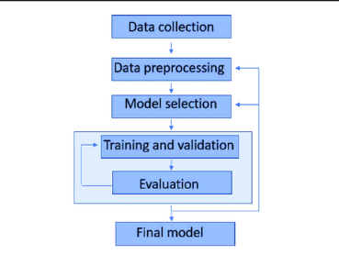
Methodology Flowchart

Slide 10
IMPLEMENTATION
1.Data Collection:
Collect Datasets of crops based on ph level of water, potassium, nitrogen, phosphorous etc
Make this Datasets as CSV files and Save it.
Then by using this collected data we train our model by using google colab
In google colab, or by using anaconda navigator jupyter notebook
2.Import the dependencies and libraries(ex:numpy ,svm etc).
3.Data Analysis from collected data.
Loading the diabetes dataset to a pandas DataFrame
Printing the first 5 rows of the dataset
Getting the statistical measures of the data

Slide 11
IMPLEMENTATION
Separating the data and labels(X,Y
4.Train the data using SVM classifier and logistic regression
5.Test and split the data
6.Model Evaluation
Accuracy Score
7.Making a Prediction system
8.Saving the trained model
Like this we have to train remaining datasets.
9.Merge this saved trained models into one program
10.Build a website using python(using streamlit library) or using html,css ,javascript etc.

Slide 12
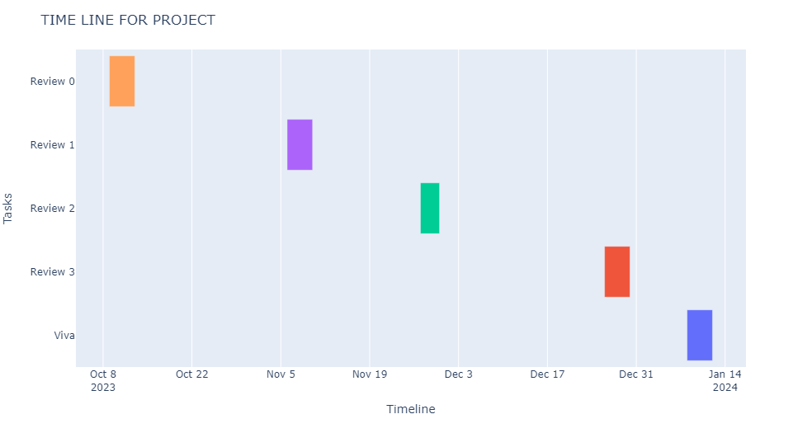
Timeline of Project

Slide 13
Expected Outcomes
In outcome, the implementation of the Farmer Portal, leveraging machine learning to provide tailored crop recommendations based on soil and water parameters, represents a significant stride towards sustainable and informed agriculture, empowering farmers to optimize yields and resources.
The development of an interactive application integrating artificial intelligence (AI) to guide farmers in crop selection based on multiple factors is a comprehensive and forward-thinking solution. By considering monsoon prediction, climate conditions, soil conditions, pests and disease predictions, demand for crops, availability of fertilizers and insecticides, as well as the distinction between irrigated and non-irrigated fields, this solution aims to empower farmers with data-driven insights for informed decision-making.

Slide 14
Conclusion
The application's reliance on AI ensures that it can process and analyze vast amounts of data from diverse sources, providing accurate and timely information to farmers. This not only enhances agricultural productivity but also mitigates risks associated with uncertainties in weather patterns, pests, and market conditions.
The personalized recommendations tailored to the geographical location of each farmer's field contribute to a more sustainable and efficient farming approach. The integration of market trends and demand analysis further aligns the agricultural practices with economic considerations, promoting profitability for farmers.

Slide 15
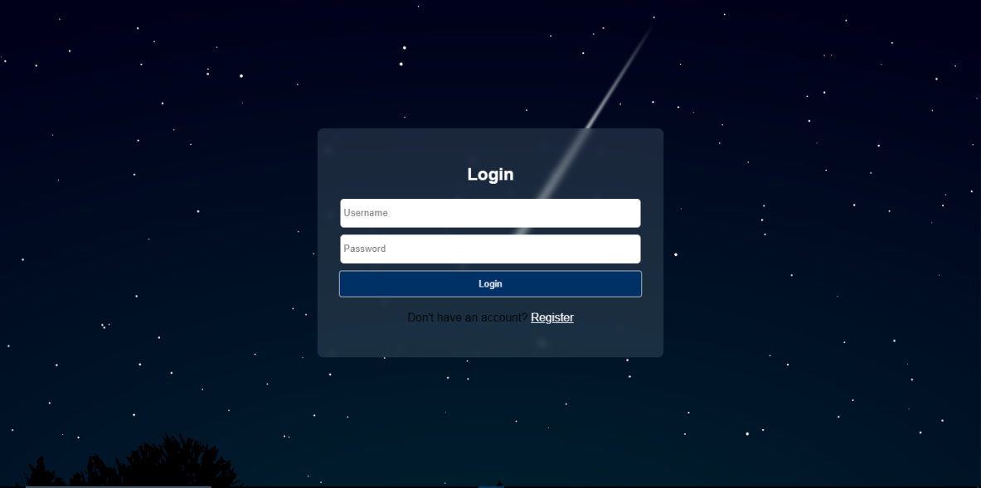
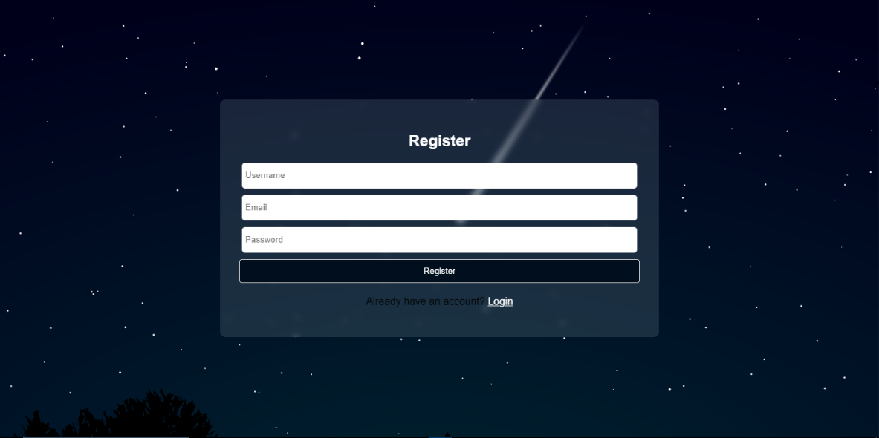
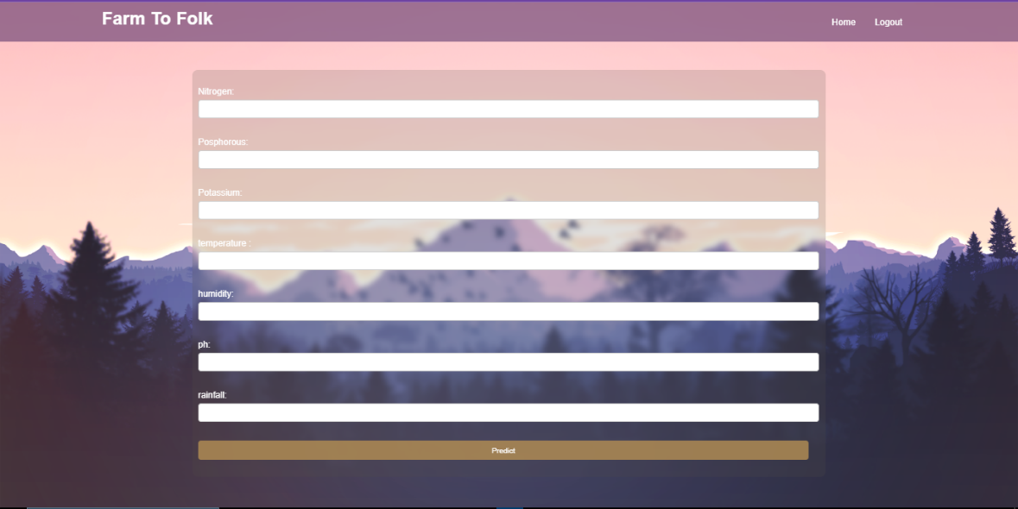

Web outputs

Slide 16
References
Adadi, A., & Berrada, M. (2018). Peeking inside the black-box: A survey on explainable artificial intelligence (XAI). IEEE Access, 6, 52138– 52160. https://doi.org/10.1109/access.2018.2870052 Atik, C., & Martens, B. (2021). Competition problems and governance of non-personal agricultural machine data: Comparing voluntary initiatives in the US and EU. SSRN Electronic Journal, 39. https://doi. org/10.2139/ssrn.3766293
Banerjee, A., Bandyopadhyay, T., & Acharya, P. (2013). Data analytics: Hyped up aspirations or true potential? Vikalpa, 38, 1–12. https://doi. org/10.1177/0256090920130401
Bostrom, N. (2012). The superintelligent will: Motivation and instrumental rationality in advanced artificial agents. Minds and Machines, 22(2), 71–85. https://doi.org/10.1007/s11023-012-9281-3
Botta, A., Cavallone, P., Baglieri, L., Colucci, G., Tagliavini, L., & Quaglia, G. (2022). A review of robots, perception, and tasks in precision agriculture. Applied Mechanics, 3(3), 830–854. https://doi. org/10.3390/applmech3030049 Bronson, K. (2019). Looking through a responsible innovation lens at uneven engagements with digital farming. NJAS: Wageningen Journal of Life Sciences, 90(1), 1–6.
Bronson, K., & Knezevic, I. (2016). Big Data in food and agriculture. Big Data & Society, 3(1), 205395171664817. https://doi.org/10.1177/ 2053951716648174

Slide 17
References
Bronson, K., Rotz, S., & D’Alessandro, A. (2021). The human impact of data bias and the digital agricultural revolution. In H. S. James Jr (Ed.), Handbook on the human impact of agriculture (pp. 119–137). Edward Elgar Publishing.
Bronson, K., & Sengers, P. (2022). Big tech meets big ag: Diversifying epistemologies of data and power. Science as Culture, 31(1), 15–28. https://doi.org/10.1145/3236024.3264838
Brun, Y., & Meliou, A. (2018). Software fairness. In Proceedings of the 2018 26th ACM joint meeting on european software engineering conference and symposium on the foundations of software engineering (pp. 754–759). Association for Computing Machinery.https://doi.org/ 10.1016/j.compag.2017.09.037
Carbonell, I. (2016). The ethics of big data in big agriculture. Internet Policy Review, 5(1), 1–13. https://doi.org/10.14763/2016.1.405
Carolan, M. (2022). Acting like an algorithm: Digital farming platforms and the trajectories they (need not) lock-in. In G. Desa, & X. Jia (Eds.), Social innovation and sustainability transition (pp. 107–119).
Springer Cham. Chlingaryan, A., Sukkarieh, S., & Whelan, B. (2018). Machine learning approaches for crop yield prediction and nitrogen status estimation in precision agriculture: A review. Computers and Electronics in Agriculture, 151, 61–69. https://doi.org/10.1016/j.compag.2018.05. 012
Dara, R., Hazrati Fard, S. M., & Kaur, J. (2022). Recommendations for ethical and responsible use of artificial intelligence in digital agriculture. Frontiers in Artificial Intelligence, 5, 884192. https://doi.org/10. 3389/frai.2022.884192

Slide 18
Thank You

